Slide 1






INFORMATION ASSURANCE AND SECURITY
DATE: 08 MAY 2026
Image Steganography System
Concealing encrypted messages inside images using LSB & AES-256
Prepared by:
Mohamed Aziz Amri
Mohamed Dhia Ben Kilani
Elaa Chaaleb

Slide 2
What we will be covering
What is steganography
Least Significant Bits (LSB) technique
System Architecture
Security Layer (AES-256)
Results & Limitations

Slide 3
Problem Statement and Motivation
Encrypted messages are visible and draw attention — sometimes the act of encryption itself is suspicious enough to get someone caught.
Our Goal
Build a desktop tool that hides AES-encrypted text inside PNG images, invisible to the naked eye and to casual inspection
Real-world uses of steganographic images’ security:
A journalist in a censored country needs to send a source document without triggering keyword filters
A company needs to watermark confidential images to trace leaks
A cybersecurity researcher needs to test whether their network monitoring tools can detect covert channels

Slide 4
What is
Steganography ?
The art of hiding the existence of a message inside an innocent-looking carrier file.
 | Cryptography | Steganography
Hides | The content | The existence
Output | Scrambled Text | Normal-looking image
Suspicion raised | Yes | No

Slide 5


Can you tell the difference?
Original Image
Stego Image
Hidden Message
“Meet me at 9PM”

Slide 6


How does LSB Steganography Work?
This is a single pixel’s RGB (Red, Green, Blue) value in binary and decimal :
Decimal Value
200
150
100
Binary Value
11001000
10010110
01100100
The letter ‘A’ 8-bit binary number 01000001
This is how the first 3 bits (0 1 0) of "A" are placed into the LSBs of RGB channels:
0
1
0
A human eye cannot distinguish a color value of 150 from 151. That is the entire principle.
New Binary Value
11001000
10010111
01100100
New Decimal Value
200
151
100

Slide 7
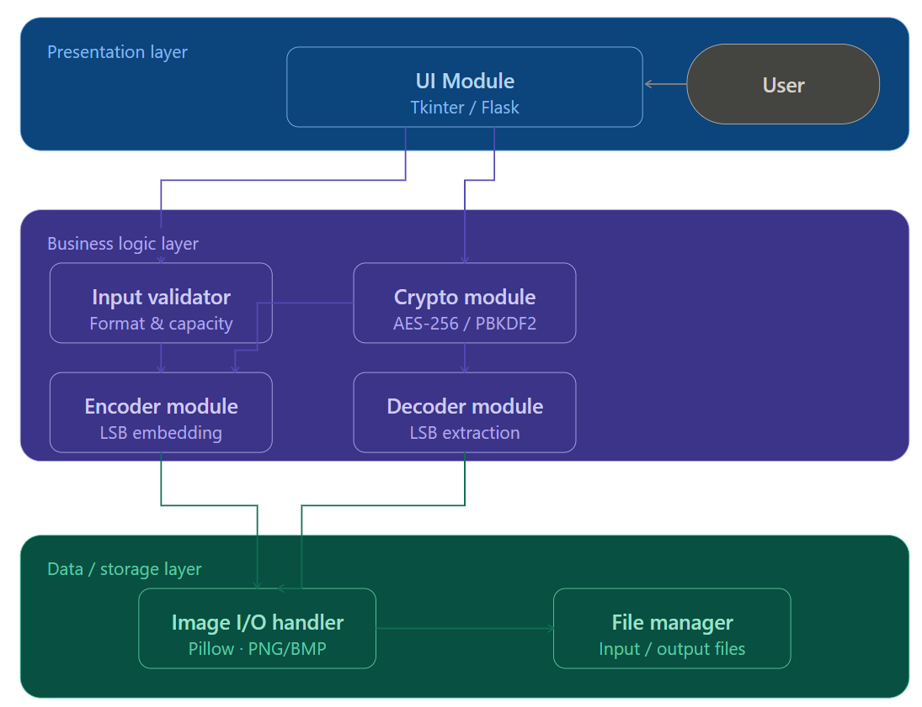
System Architecture
three-layer component overview

Slide 8
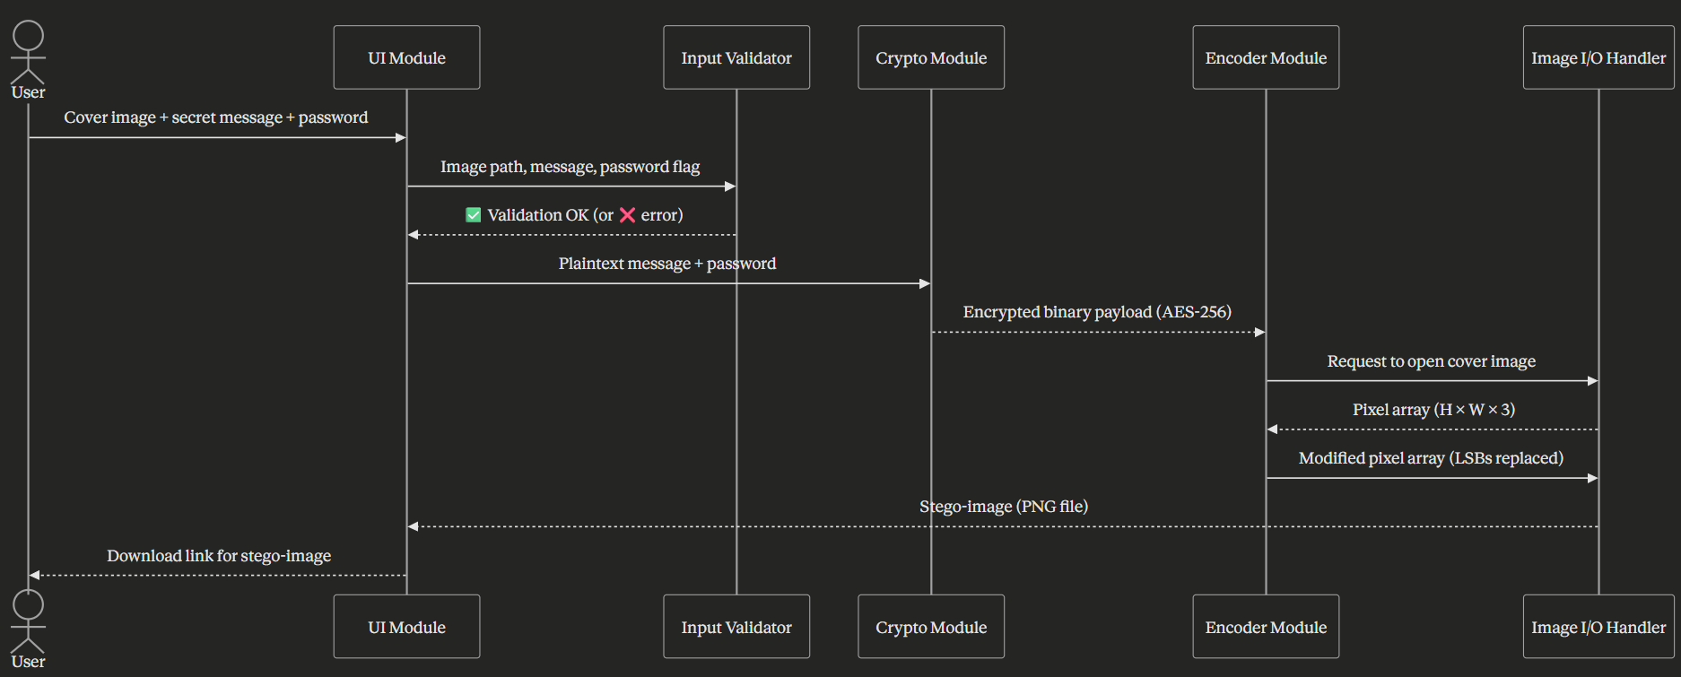
System Architecture
Encode path

Slide 9
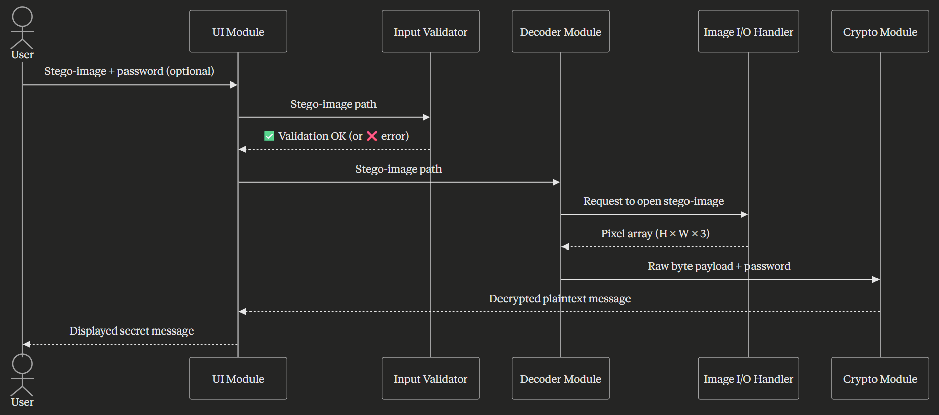
System Architecture
Decode path

Slide 10
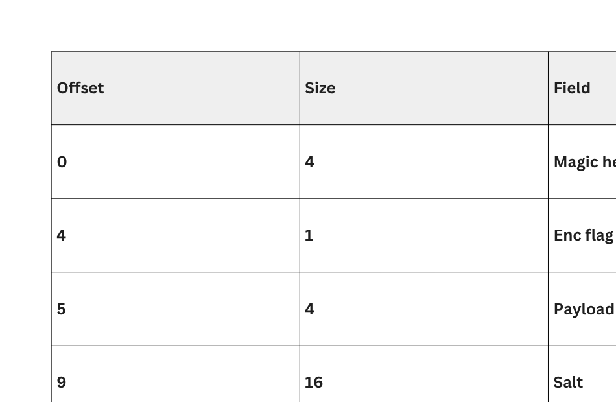
Binary Payload format

Slide 11






Security Layer
Without encryption, anyone who suspects steganography can extract the raw bits and read the message.
AES-256-CBC
PBKDF2-SHA256
256-bit symmetric encryption
military-grade
200,000 iterations
brute-force extremely slow
Our Security Stack
AES-256-CBC — 256-bit symmetric block cipher, with 14 rounds of substitution, permutation, and transformation.
PBKDF2-SHA256 — a password-based key derivation function (PBKDF2) that produces a secure, salted key.
Random Salt (16 B) — ensures that identical passwords produce unique hash outputs
Random IV (16 B) — ensure that encrypting the same plaintext multiple times with the same key produces different ciphertexts
Random Salt (16 B)
Random IV (16 B)
Generated fresh per message
blocks pre-computation attacks
Same message encrypted twice
→ different ciphertext
Even if the stego-image is intercepted, the message stays unreadable without the password.

Slide 12






Key Features of the System
Mandatory Password
Live Capacity Counter
Password Strength Meter
Wrong Password Detection
Histogram Analysis
Random Salt Per Message
Encoding and decoding always require a password — no access without it.
Shows how much data the image can still store in real time.
Rates passwords instantly from Weak to Very Strong.
Displays a clear error banner if the password is incorrect.
Compares image data before and after hiding the message.
Each message is encrypted uniquely, even with the same password.

Slide 13
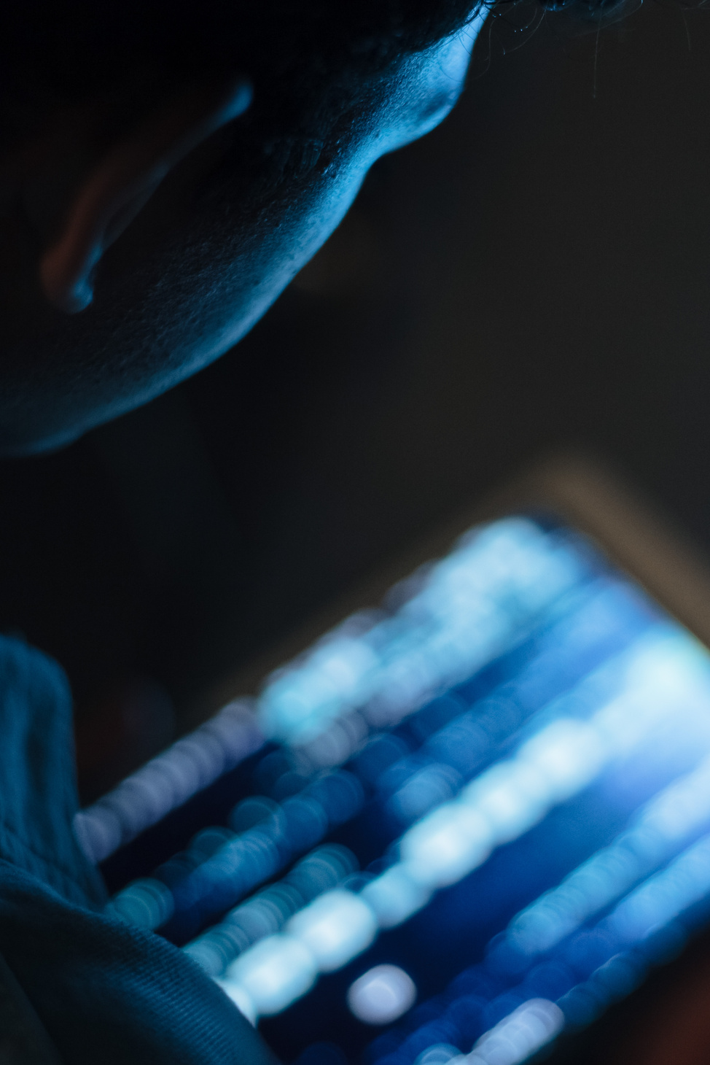
INFORMATION ASSURANCE AND SECURITY
DATE: 08 MAY 2026
Live Demonstration

Slide 14
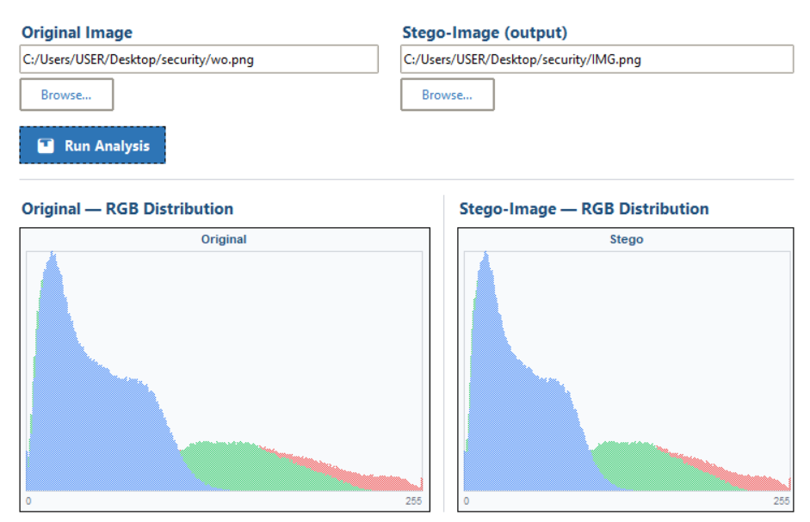
Results & Imperceptibility Analysis
VISUAL OBSERVATION
THE STEGO IMAGE APPEARS IDENTICAL TO THE ORIGINAL IMAGE
TECHNICAL EXPLANATION
ONLY THE LEAST SIGNIFICANT BIT (LSB) IS MODIFIED PER CHANNEL
CHANGES ARE TOO SMALL TO BE DETECTED BY THE HUMAN EYE
SECURITY RESULT
MESSAGE IS ENCRYPTED USING AES-256-CBC
KEY DERIVED USING PBKDF2 (200,000 ITERATIONS)

Slide 15


INFORMATION ASSURANCE AND SECURITY
DATE: 08 MAY 2026
Limitations & Future Improvements
SUPPORTS ONLY PNG & BMP FORMATS
LIMITED CAPACITY DEPENDING ON IMAGE SIZE
NO AUDIO OR VIDEO SUPPORT
CAN BE DETECTED BY ADVANCED TOOLS
IMPLEMENT MORE ADVANCED ENCRYPTION TECHNIQUES
ADD DETECTION (STEGANALYSIS) MODULE
DEVELOP MOBILE APPLICATION
AUTO-CONVERT JPEG TO PNG
THIS PROJECT DEMONSTRATES THAT MEANINGFUL SECURITY TOOLS CAN BE BUILT FROM FOUNDATIONAL PRINCIPLES — LSB SUBSTITUTION COMBINED WITH AES-256 ENCRYPTION PRODUCES A SYSTEM THAT IS BOTH VISUALLY IMPERCEPTIBLE AND CRYPTOGRAPHICALLY SOUND

Slide 16

INFORMATION ASSURANCE AND SECURITY
DATE: 08 MAY 2026
Thank You!

